Slide 1

Prepared by Badar Hossain
Slicing Through Data: Analyzing Pizza Sales with SQL"

Slide 2
Introduction
In this project, I explored a dataset on pizza sales using SQL to uncover key business insights. With structured queries, I analyzed various aspects of the data, such as total sales by pizza type, peak sales periods, and customer preferences. By leveraging SQL’s powerful querying capabilities, I was able to extract and interpret meaningful patterns directly from the data.
The following slides showcase the SQL queries I developed and the resulting outputs, illustrating each step of the analysis. This approach provides a clear, data-driven perspective on how SQL can support decision-making in a retail environment.

Slide 3

Query objectives:
The Questions:
Determine the distribution of orders by hour of the day
Determine the top 3 most ordered pizza types based on revenue
Calculate the percentage contribution of each pizza type to total revenue
Analyze the cumulative revenue generated over time
Determine the top 3 most ordered pizza types based on revenue for each pizza category

Slide 4
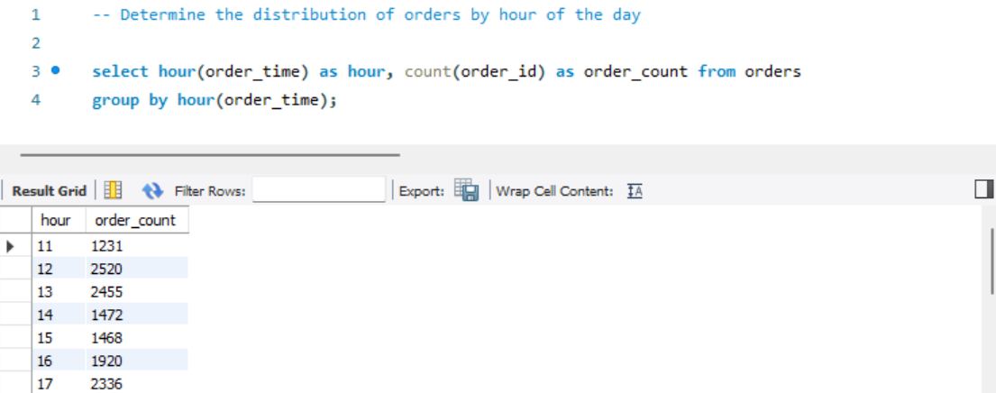
Determine the distribution of orders by hour of the day

Slide 5
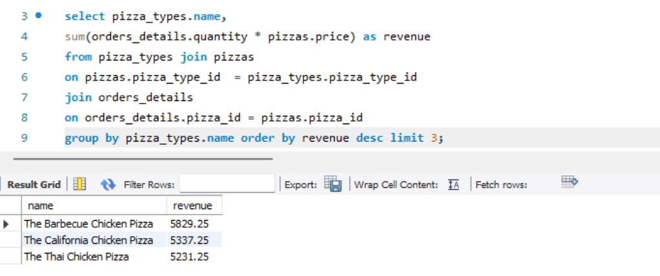
Determine the top 3 most ordered pizza types based on revenue

Slide 6
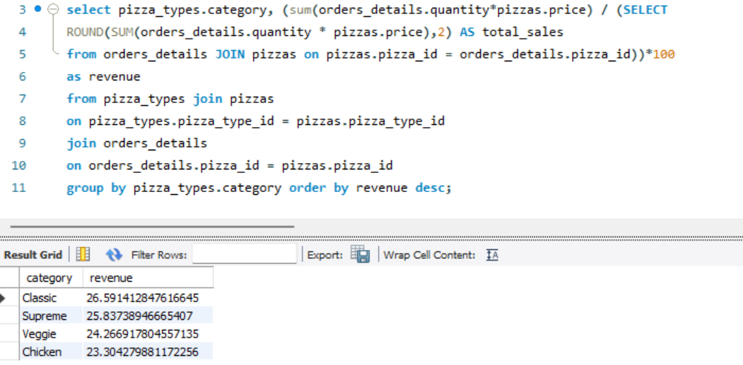
Calculate the percentage contribution of each pizza type to total revenue

Slide 7
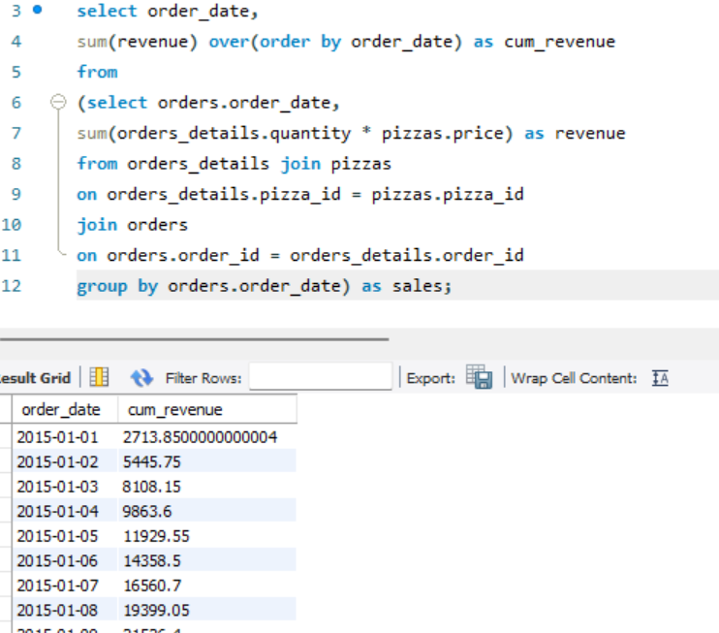
Analyze the cumulative revenue generated over time

Slide 8
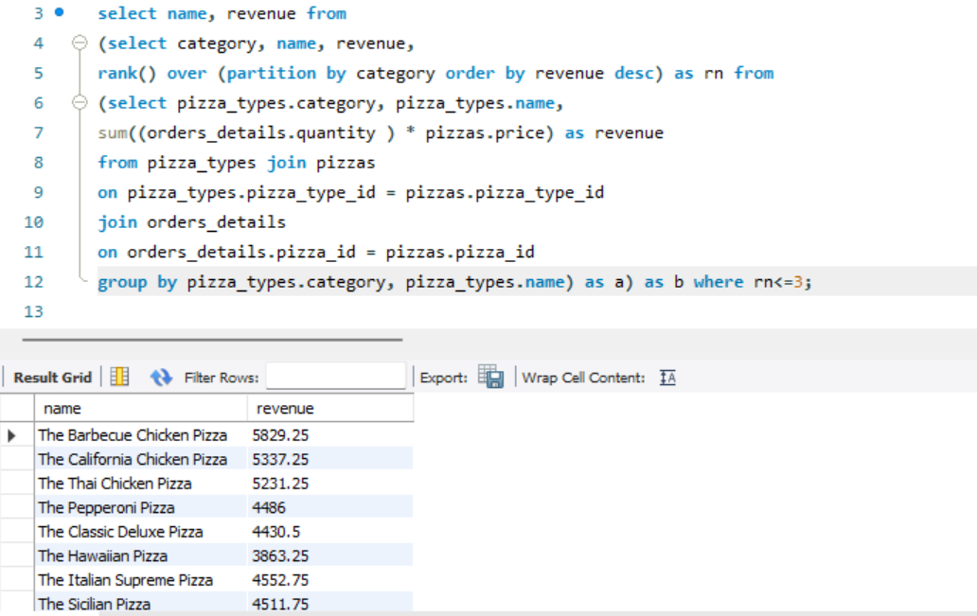
Determine the top 3 most ordered pizza types based on revenue for each pizza category

Slide 9
Conclusion
This SQL analysis of pizza sales revealed key insights into order timing, popular pizza types, and revenue distribution. By identifying peak ordering hours and top-performing pizzas by revenue, the analysis supports targeted promotions and optimized inventory. Tracking each pizza type’s revenue contribution and growth over time highlights profitability trends, helping to tailor offerings to customer preferences. Overall, SQL proved invaluable in guiding data-driven decisions for better business outcomes.

Slide 10
Thank you

